Slide 1

Total Cost Of Ownership:
Your Travel Payment Solution
February 22, 2018

Slide 2
Agenda
1
Payment Methods: Pros & Cons
2
Corporate Cards
3
Central Travel Accounts
4
Fees
5
Reconciliation & Reimbursement
6
Virtual Payment

Slide 3

Payment Methods: Pros & Cons

Slide 4






Travel Programs Rely On A Variety Of Payment Methods
Payment Methods That Company’s Travelers Can Use
90%
Invoice
23%
Corporate
credit card
Direct supplier
invoice
55%
22%
Personal
card/ cash
Company cash
advances
$
53%
10%
Central Travel
Account
Single-use
virtual account
Larger companies are less likely to allow their travelers to use personal credit or cash when compared with SME’s

Slide 5
Prevalence Of Corporate Cards Within A Company
Of the Travel Managers whose company has corporate cards….
64%
say cards have been issued to less than half of employees company-wide

Slide 6
Non-corporate Payment Methods Still Play a Role
Of the companies that have corporate cards…
Invoice
54%
23%
20%
Allow travelers to use personal cards/cash at least in some cases
Rely on direct supplier invoicing at least in some cases
Provide company cash advances at least in some cases

Slide 7
Payment Methods: Pros and Cons
PROS
CONS
Corp Cards
Flexibility to make transaction at point of sale
Rewards can be linked to personal cards in some cases
Easy to set spend limits and monitor
Corporate cards are difficult with infrequent and non-employee travelers
Increased risk of fraud
Compliance can be harder to enforce
Central Bill
Fully reconciled statement
Easy to administer & maintain
Reduced risk of fraud & increased compliance
Cannot be used for meals and incidentals
Company liability
Various levels of enhanced data
Personal Credit/Cash
No card usage to monitor & no risk
Float for employer from employee
Lack of visibility into spend data
No automatic feed to EMS/GL software
Travelers with little credit are burdened

Slide 8
Payment Methods: Pros and Cons
PROS
CONS
Direct Bill
Flexibility in invoicing
Greater float
Potential for discount
Limited transaction information
One extra bill to process and reconcile
Difficult to import data into EMS/GL systems
Cash Advance
No fees
Acceptance
No transaction data capture at time of transaction
Increased fraud potential due to lack of visibility of spend
Negative float
Virtual
Almost no risk of fraud
Integrated with EMS/GL
Visibility
Some travel suppliers are still uneducated about the payment method
Uneven levels of acceptance

Slide 9

Corporate
Cards

Slide 10
Travel Managers Are Satisfied With Several Elements of Their Card Program

Slide 11
They Are Ambivalent With Their Card Program When It Comes to Data and Internal Cost Savings

Slide 12

Central Travel Accounts

Slide 13
The Central Billing Evolution
Today
Mid 1990’s
Kiosk check in allowed
Rail added
Electronic file export
Automated CC Rec
Air, Rail, Car & Hotel
TMC fees related to transactions
Pre - Invoice Reconciliation
Daily feed to T&E systems
Automated upload to financial systems
Automated allocation to GL
Travel Agency Fees added
Limited electronic files
Manual CC Rec
Airline tickets only
Simple statements
Limited data
Early mid 2000’s
In the beginning

Slide 14
Travel Managers Are Very/Satisfied With Various Elements of Their CTA

Slide 15
Where Travel Managers See Opportunity For Improvement

Slide 16

Rebates and
Fees

Slide 17
Do You Know What Fees You Are Charged?
If you don’t know what you are being charged, you might be missing a savings opportunity.

Slide 18
Of the 80% of Companies That Receive Rebates, Most Receive the Full Amount
But 25% have no idea how much of a rebate they are receiving

Slide 19
Rebates – Understanding the fine print
Ramp Up Period
Rewards / Executive Program
Understanding
Rebates
Minimum Spend
Yearly / Per card
Corporate Pay vs.
Individual Pay
Exclusions
Notes:
Rewards – deducted from payout. Ramp up – sufficient to meet 1st year goal. Pay – penalty for late payment, different tier if individual pay Exclusions – High cost transactions

Slide 20

Reconciliation and Reimbursement

Slide 21
A Majority of Companies Reconcile Expense Data Internally
Do you know the time/effort that your company expends to manage expense reconciliation?

Slide 22
What Department Is Responsible For Reconciliation?
Think about how automation could save time and money with expense reconciliation.

Slide 23
How Do You Bill-back Clients For Travel Expenses?
45%
of companies bill-back clients for travel expenses
Does Your Payment Provider Offer Flexible Payment Terms That Allow You To Bill-back Your Clients More Than Monthly?

Slide 24

Virtual Payment

Slide 25

What Is Virtual Payment?
The customary aspects of a virtual card
Traditional credit card number, without the physical card
Transaction specific, one–to–one payment
  Authorized for a specific transaction
  Range of dates
  Amount cap
  Vendor restrictions
Once the transaction is complete, the account number is inactive
Specific traveler data collected at time of card creation, allows for easy allocation
Along with virtual payment – mobile application of virtual payment is a new innovation available in the market.

Slide 26
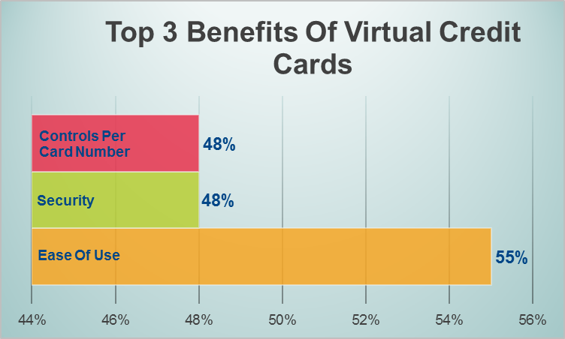
Virtual Payment On The Rise
The use of virtual cards as a form of payment has risen dramatically. In research conducted earlier this year, virtual card usage was below 1% in 2016 and has shot to over 10% in 2017*
* Based on International Travel Management Study 2017 – AirPlus International

Slide 27




Why Virtual Payment?
Features To Verify When Selecting Virtual Payment
SECURE
GLOBAL
Limit Control
Defined Validity Dates
Restricted Merchants
Local Support
Consistent Process
Regionally Relevant
INTEGRATION
AUTOMATED
Booking System
T&E
Finance GL
Enhanced Data
Reconciliation
Payment

Slide 28

Is Virtual Payment relevant to your business?
Do you have?
Non-employee Travel
  Consultants
  Recruits
  Guests
Infrequent Travelers
Employees with low/no credit
To bill-back customers
Reconciliation challenges
Virtual Payment alleviates these pain points and more!

Slide 29
Virtual Payment Benefits Throughout Your Company
Travel
Mgmt
Detailed Data
Ease of Implementation
Procure-ment
Total Cost of Ownership
Detailed Reporting
Finance
Secured Payment
Automated Reconciliation
Traveler
System Integration
Ease of Use
Program Compliance
Program Compliance
Simplified Expense Reporting
Notes:
Don’t have to use personal card
No cash advance
Automated expense reporting

Slide 30
In Review – Your Payment Program Has Many Elements
Data Detail & Quality
Total Cost of Ownership
Currency Settlement
Rebate
Reconciliation
Fees
Fraud Risk
Is Your Payment Program Optimized To Your Specific Travel Program Needs?

Slide 31
Considerations Other Than The Numbers
Total Cost of Ownership
Service
Consistency
Grow With Client & Innovate
Global/ Multinational Fit
Don’t forget to consider value-added qualitative aspects of a payment provider.

Slide 32

Thank you! Contact us:
703.373.0940 usa@airplus.com

