Slide 1
CNFBTA June Member Luncheon - Regional Economic Update - Jacksonville, FL

Slide 2
DETAILS:
TAKING A LOOK
When one thinks of Florida the first thought that comes to mind is “Miami and the Mouse” but Florida can actually be broken into a number of different personalities when regions are separated.
Northeast Florida has the largest manufacturing base in the state. It has a much lower retirement population then most associate with Florida and a younger work force.. With Jacksonville’s port becoming a major gateway to America’s southeast and central regions it is attracting international and domestic companies such as SAFT, the French lithium ion battery manufacturer, 2G-Cenergy, one of Germany’s leading manufacturer of large mobile generation equipment using bio-gas, and Pilot Pen of Japan who located their manufacturing and U.S. corporate headquarters to Jacksonville.
Jacksonville’s strategic location as one of the country’s top logistics and distribution centers provides manufacturers with ability to bring in raw materials and ship their finished products to customers in a cost effective and time sensitive manner. Jacksonville is at the cross road of three of the nations major railroads, CSX, Norfolk Southern, and Florida East Coast can have cargo in Chicago and Detroit in less then 45 hours and Miami in 10 hours. Access to I-95, I-10, and I-75 provides 8 hour truck delivery times to the entire southeast and overnight delivery to everything east of the Mississippi.
.
4

Slide 3
DETAILS:
TAKING A LOOK (Continued)
First impressions are always important but it is the second and more in-depth analysis that can make the difference between locating in what seems to be the least expensive location rather then a location that will offer the best overall
The Jacksonville region experiences the W&W Effect for most people who reside outside Florida. First they ask “where” then after spending a little time in the region they say “wow”
Northeast Florida is also being discovered as a great place to live and invest by many who are accessing the EB5 Immigration program
4

Slide 4
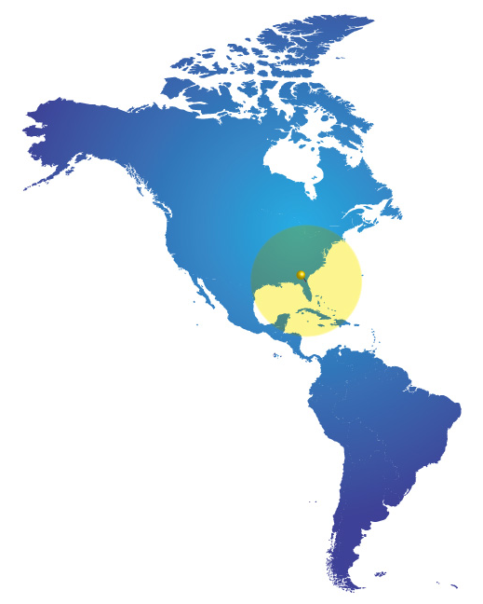
JACKSONVILLE:
In The Center Of The Western Hemisphere
5

Slide 5
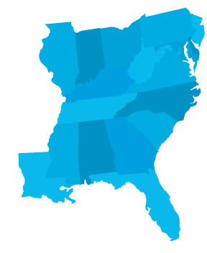

STRATEGIC LOCATION
8-hour Drive Time
50 Million People
New York
Chicago
Cleveland
Pittsburgh
Philadelphia
Cincinnati
Washington, D.C.
Richmond
Nashville
Charlotte
Columbia
Montgomery
Atlanta
95
75
JACKSONVILLE
10
New Orleans
Tampa
Miami
6

Slide 6
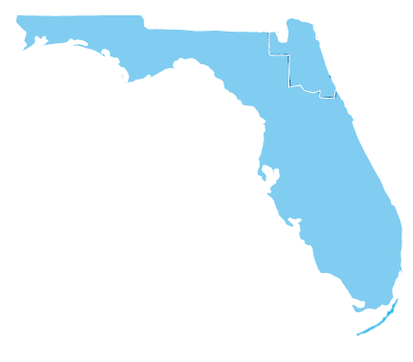
JACKSONVILLE AND NORTHEAST FLORIDA
10
JACKSONVILLE
Tallahassee
Northeast Florida Area Counties
75
Orlando
Baker
Tampa
4
Clay
Duval/Jacksonville
Flagler
75
95
Nassau
Putnam
St. Johns
Miami
7

Slide 7
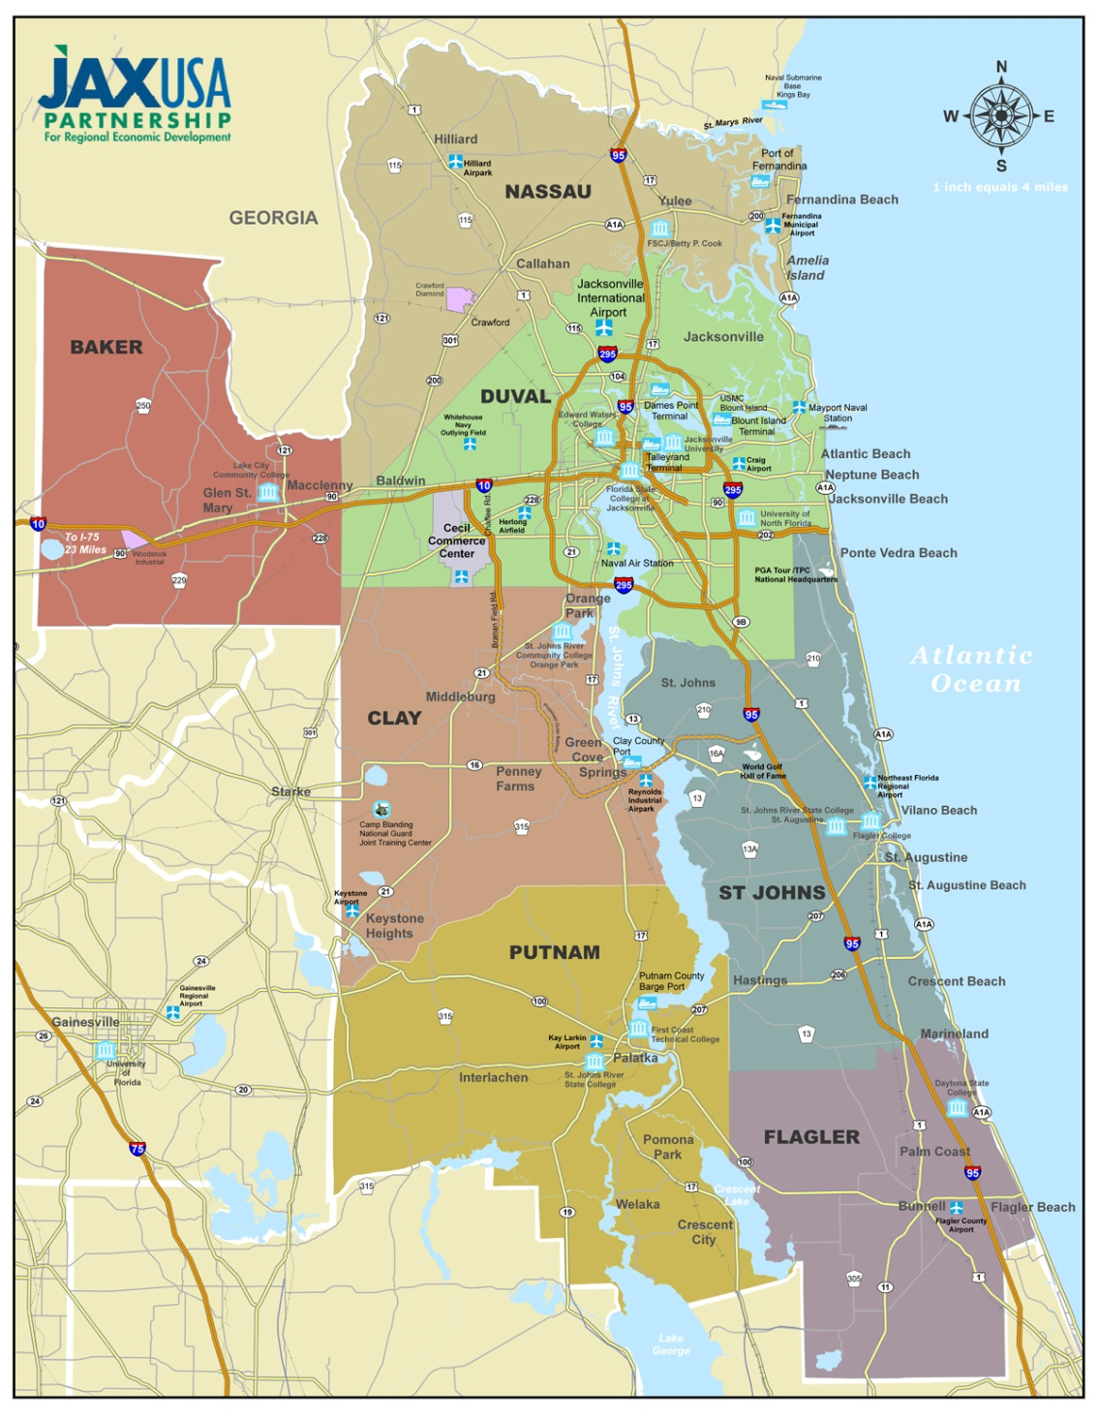
NORTHEAST
FLORIDA
8

Slide 8
BUSINESS DIVERSITY
EMPLOYMENT BY SECTOR
Source: Florida Department Of Economic Opportunity, 2010
9

Slide 9
JAX REGIONAL BUSINESS DRIVERS
Manufacturing, Logistics & Distribution
Finance & Insurance Services
Defense & Aerospace
Health Sciences
10

Slide 10
JAX FACTS
Consolidated Government
875 Square Miles- Largest City in Land Mass in U.S.
Four Distinct Seasons
  Winter Average High of 66.5˚F (19.16˚C)
  Summer Average High of 90.8˚F (32.66˚C)*
Average Commute Time of 25.2 Minutes**
Largest Urban Park System in the U.S.
*Source: Southeast Regional Climate Center , 1948-2011
** Source: U.S. Census Bureau
11

Slide 11

























INDUSTRY LEADERS
FORTUNE
500
CORPORATE
HEADQUARTERS
RECENT ANNOUNCEMENTS
12

Slide 12
WHAT OTHERS ARE SAYING ABOUT JAX
Inc. …Top 10 Best Cities for Doing Business
Forbes… Top 10 Best U.S. Cities for Jobs
Portfolio.com… Top 50 Best Labor Markets for Young Adults
Expansion Management…Top 50 “Hottest City” for Business Relocation in the U.S. for Nine Straight Years and Only City to be Ranked 1st Three Times
Forbes… Top 10 for Best Cities for Technology Jobs
Business 2.0…Top 10 Hottest Cities That Will Lead Job Growth through 2015
Tax Foundation…Florida Ranked 5th Best Tax Climate in the U.S.
13

Slide 13
NORTHEAST FLORIDA POPULATION
2% Annual Growth Rate
Source: Decision Data Resources
14

Slide 14
JAX WORKFORCE
Total Labor Force = 700,000
3,000 Military Personnel Separations Each Year
Median Age= 37.8 (Florida Median Age= 40.5, U.S.= 37.1)*
Florida is a Right-to-Work State by Constitution
Jacksonville Unionization is 1.9% in the Private Sector*
*Source: www.unionstats.com
15

Slide 15
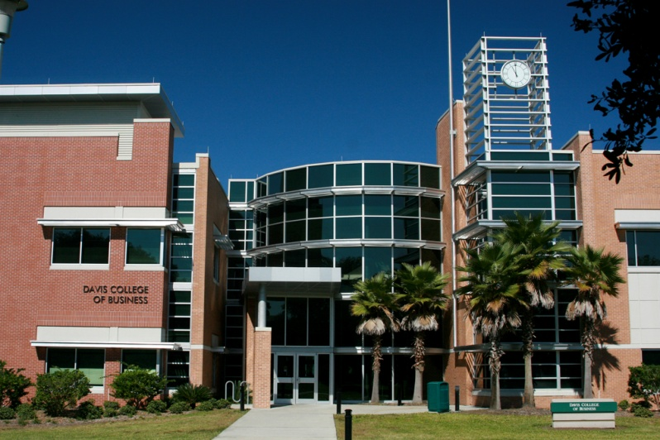
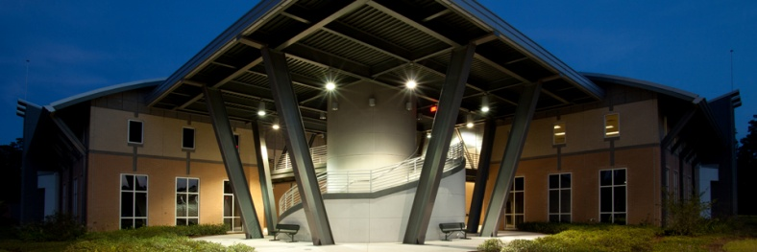
HIGHER EDUCATION
JAX MSA
University of North Florida (UNF)
Jacksonville University (JU)
Edward Waters College
Embry-Riddle Aeronautical University (ERAU)
Flagler College
Jones College
Florida State College at Jacksonville (FSCJ)
St. Johns River State College (SJR State )
Webster University
Florida Coastal School of Law
University of Phoenix
Columbia College
Florida Technical College
ITT Technical Institute
First Coast Technical Institute
Florida Metropolitan University
Nova Southeastern
NORTH FLORIDA
University of Florida (UF)
Florida State University (FSU)
Florida A & M University (FAMU)
JU Davis College of Business
17

Slide 16
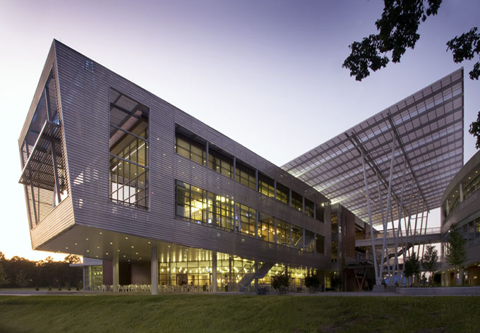
UNIVERSITY OF NORTH FLORIDA
16,000 Students
Logistics Management Programs Ranked Top in the Nation*
Electrical, Mechanical & Civil Engineering
Master’s & Doctoral Programs
Ranked Among Top Southern Universities for Master’s Programs**
Accounting Division Ranked Among Best in U.S.***
Student Union
*Source: Supply Chain Management Review Survey, 2005
**Source: U.S. News America’s Best Colleges Report, 2007
***Scored Higher on CPA Exam Than Any Other College in Nation
18

Slide 17
NORTHEAST FLORIDA STATE COLLEGE SYSTEM
Florida State College
St. Johns River State College
Combined Enrollment= 83,000
14 Campuses and Learning Centers within One- Hour Commute
Customized Career Training at Low or No Cost
19

Slide 18

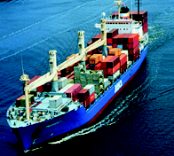
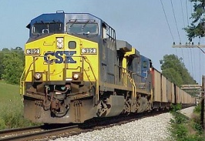
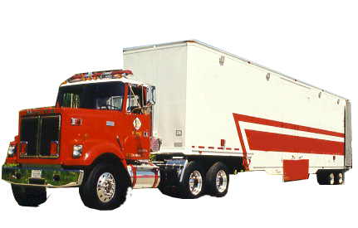
INTERMODAL TRANSPORTATION
95
10
INTERMODAL
SYSTEM
-3 Interstates
75
-3 Major Rail Roads
-2 Deep Water Ports
95
-4 Marine Terminals
-Growing International Airport
20

Slide 19
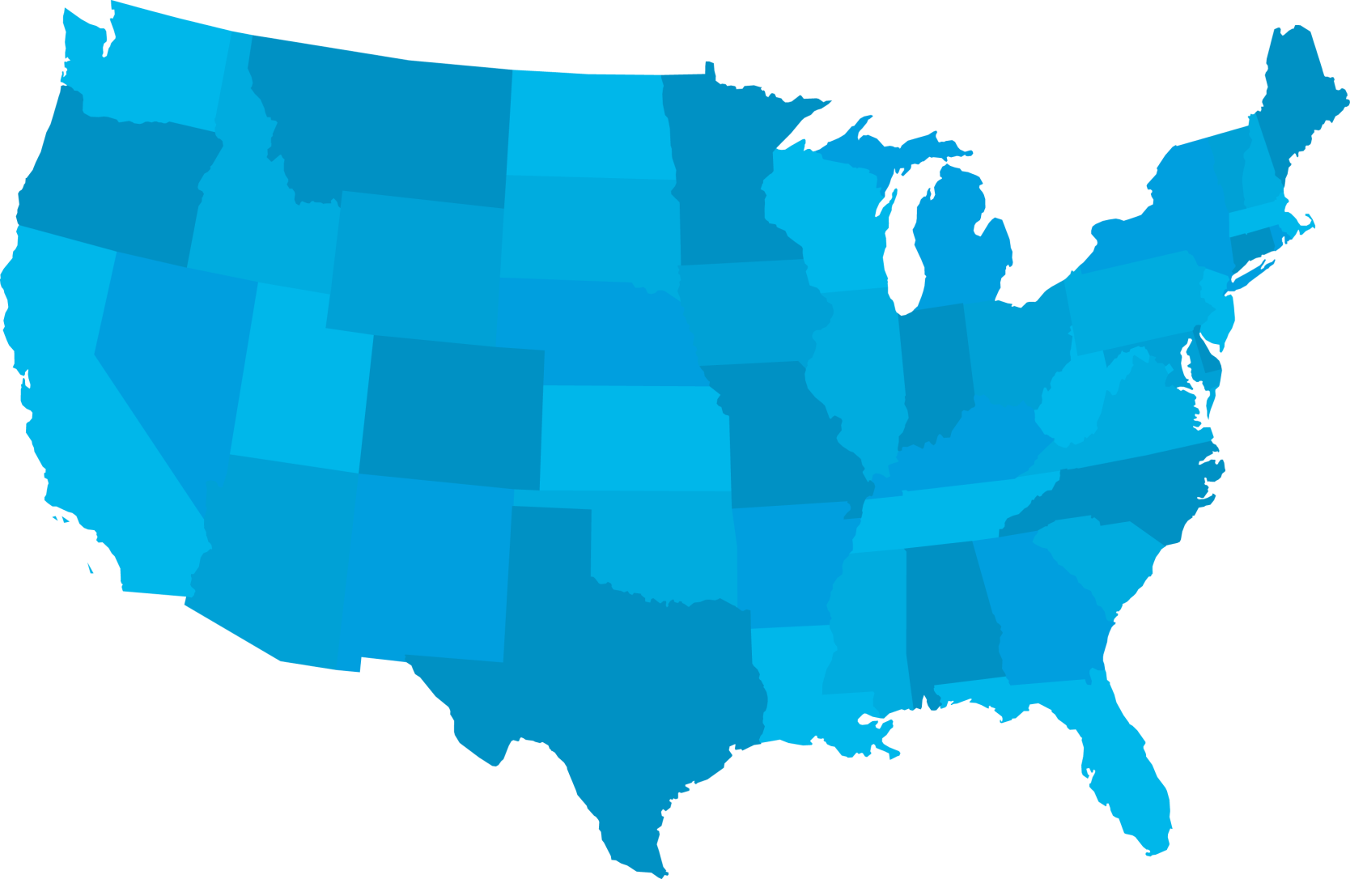
ACCESS BY AIR
Minneapolis
Boston
Detroit
New York
La Guardia
JFK
Newark
Chicago O’Hare
Philadelphia
Denver
Washington Dulles
Washington National
Cincinnati
Baltimore
Las Vegas
Norfolk
Nashville
Charlotte
Memphis
Dallas/
Ft. Worth
Atlanta
Birmingham
Houston International
Houston Hobby
JACKSONVILLE
Tampa
Ft. Lauderdale
Miami
San Juan
21

Slide 20
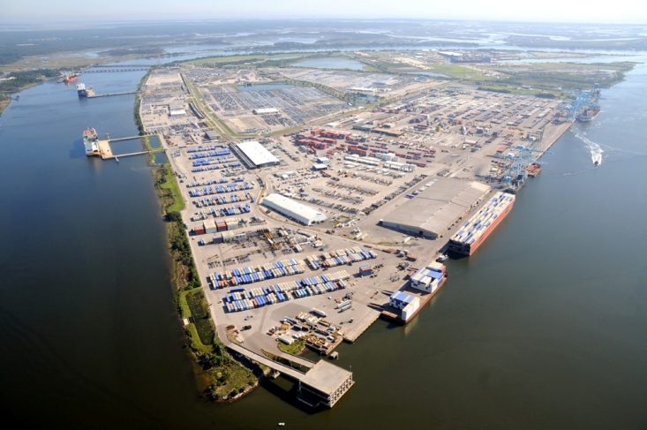
JAXPORT & PORT OF FERNANDINA
MARINE OPERATIONS
Shipping Lines to Asia, Europe, South America & the Caribbean
#2 Automobile Processing Port in U.S.
2 Natural Deep Water Ports
4 Maritime Terminals with Expansion Potential
Blount Island Terminal
22

Slide 21
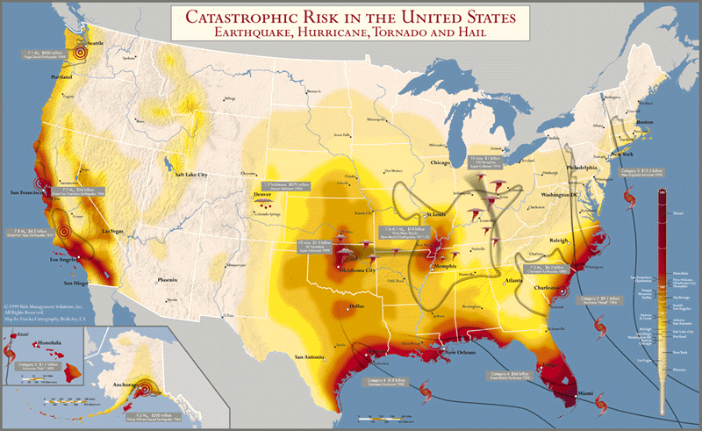
CATASTROPHIC RISK
23

Slide 22
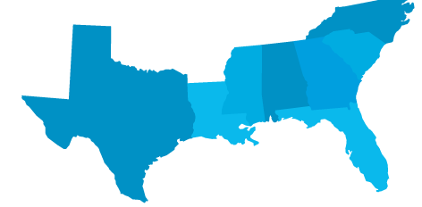
FLORIDA’S FIRST COAST PROTECTED LOCATION
Storm Protection from Gulf Stream and Recurvature Effect
Statistically the LEAST Likely Place for a Hurricane on the East or Gulf Coasts
Only One Hurricane in Recorded History
JACKSONVILLE
24

Slide 23
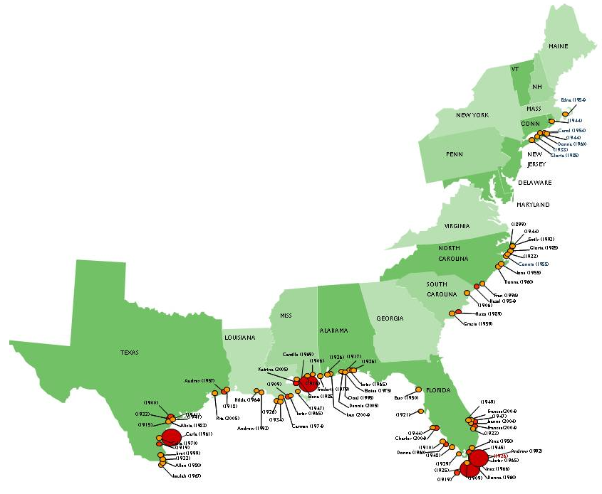
MAJOR LANDFALLING HURRICANES
1899-2011
Category 3
Category 4
Category 5
Source: National Climate Data Center
25

Slide 24
CONSTRUCTION COST COMPARISON
National Average = 100
Source: RS Means Construction Cost Data 2012
26

Slide 25

COST of LIVING COMPARISON
National Average = 100
Portland
111.6
Green Bay
96.0
Boston
132.4
New York
207.9
Chicago
114.9
Salt Lake City
101.2
Washington, D.C.
141.3
San Francisco
162.0
Denver
103.9
Richmond
102.6
St. Louis
90.9
Memphis
87.7
Raleigh
97.0
Oklahoma City
89.9
Charleston
99.8
Phoenix
103.0
Atlanta
93.6
Montgomery
100.6
Dallas
92.9
JACKSONVILLE
94.9
Austin
96.6
Tampa
92.4
Miami
107.0
Source: ACCRA Cost of Living Index, 3rd Quarter 2011
27

Slide 26
HOUSING COSTS
More House For Your Money
2,400 Sq. feet
22.9 Meters
3 Bed/2 Bath
Source: ACCRA Cost of Living Index, 3rd Quarter 2011
28

Slide 27
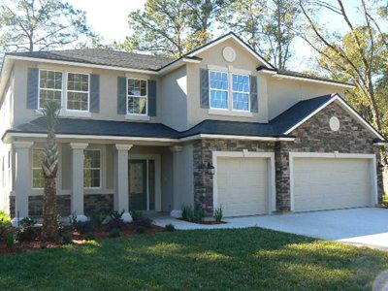
HOUSING COSTS
Median New & Resale Price: $137,100*
New: $347,990
Source: National Association of Realtors, 3rd Quarter 2011
29

Slide 28
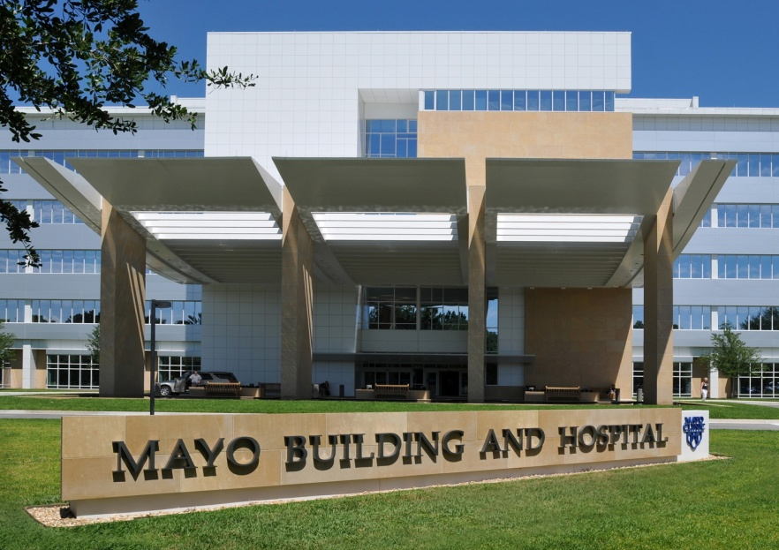
OUTSTANDING MEDICAL FACILITIES
More Than 10 Major Hospitals and Medical Centers
Mayo Clinic
Baptist Health | Memorial Hospital
Mayo Clinic | Flagler Hospital
St. Vincent’s Medical Center | Northeast Florida State Hospital
Shands Jacksonville | Orange Park Medical Center
St. Luke’s Hospital | Baptist Medical Center- Beaches
More Than 2,000 Physicians in the Region
University of Florida Proton Therapy Institute
One Of Only 7 In The U.S. For Cancer Treatment
30

Slide 29
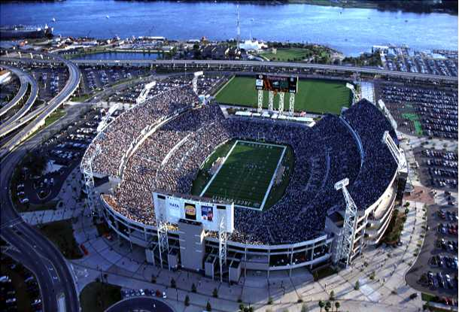
Jacksonville Jaguars
UNIQUE AMENITIES
33

Slide 30
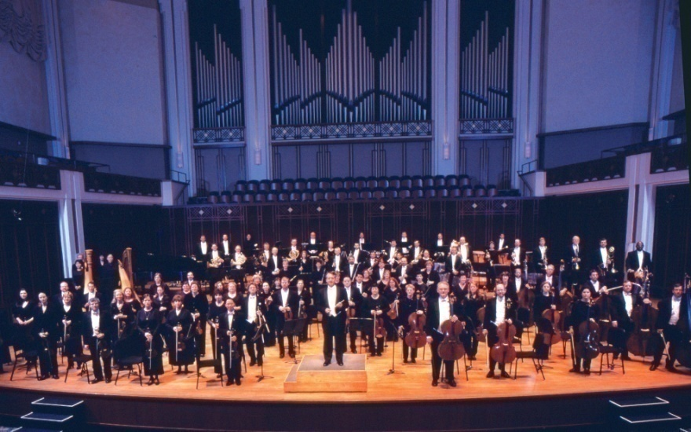
Jacksonville Symphony
UNIQUE AMENITIES
34

Slide 31
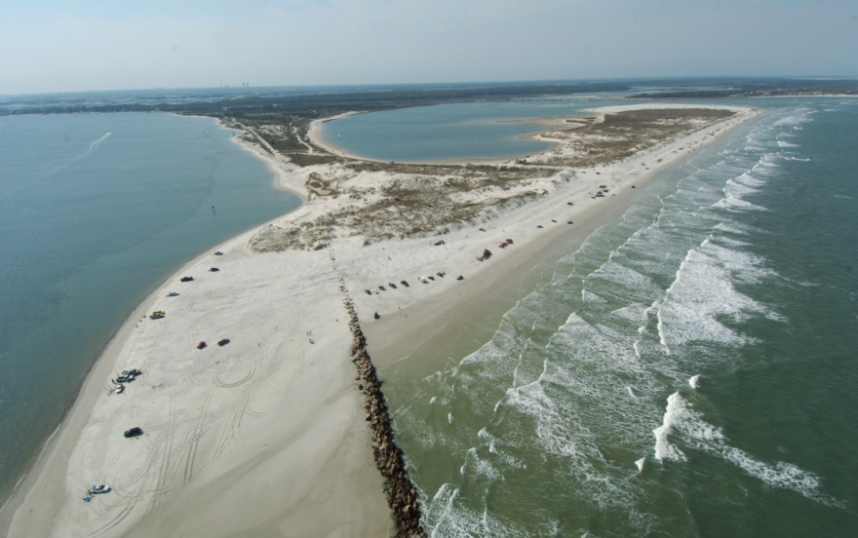
Beaches & Intracoastal
UNIQUE AMENITIES
35

Slide 32
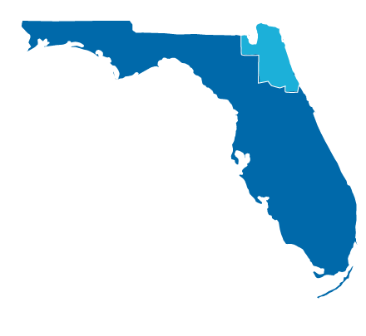
JACKSONVILLE & NORTHEAST FLORIDA
Intermodal Transportation System
Young, Dynamic Workforce
Central to Southeastern Markets
Growing Manufacturing and Distribution Center
Moderate Climate
Minimal Hurricane Exposure
Southern hospitality combined with Florida coastal lifestyle
36

Slide 33
TRENDS IN NEW DEVELOPMENT
International manufacturing
Companies re-locating from high tax states
Jaxport and logistics networks attracting companies looking for easy access to southeastern markets
Consolidation of financial operations by large firms
Growth of IT in manufacturing and other industries
36

